Slide 1
Lab5 Questions
Yao Zhao

Slide 2
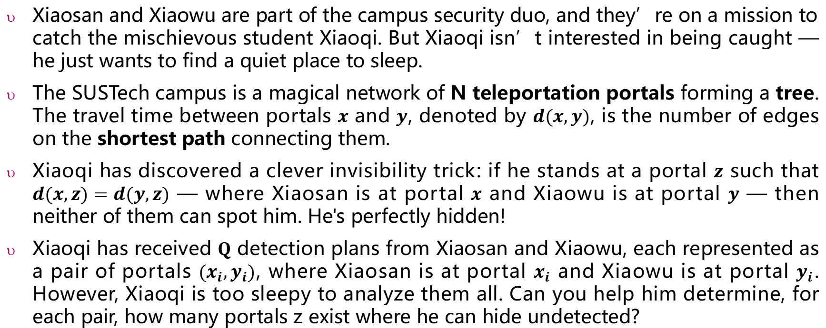
Lab5.A: Hide And Seek
Xiaosan and Xiaowu are part of the campus security duo, and they’re on a mission to catch the mischievous student Xiaoqi. But Xiaoqi isn’t interested in being caught — he just wants to find a quiet place to sleep.
The SUSTech campus is a magical network of N teleportation portals forming a tree. The travel time between portals $x$ and $y$, denoted by $d(x,y)$, is the number of edges on the shortest path connecting them.
Xiaoqi has discovered a clever invisibility trick: if he stands at a portal $z$ such that $d(x,z)=d(y,z)$ — where Xiaosan is at portal $x$ and Xiaowu is at portal $y$ — then neither of them can spot him. He's perfectly hidden!
Xiaoqi has received $Q$ detection plans from Xiaosan and Xiaowu, each represented as a pair of portals $(x_{i},y_{i})$, where Xiaosan is at portal $x_{i}$ and Xiaowu is at portal $y_{i}$. However, Xiaoqi is too sleepy to analyze them all. Can you help him determine, for each pair, how many portals z exist where he can hide undetected?

Slide 3
Input
SUSTech
5
1 2
1 3
3 4
3 5
3
4 5
1 2
3 3
5
1 2
1 3
3 4
3 5
1
2
3
4
5
Plan 1
SUSTech
OK, d(4,1)=d(5,1)=2
1
OK, d(4,2)=d(5,2)=3
OK, d(4,3)=d(5,3)=1
Plan 1:
3
2
3
4
Xiaosan
5
Xiaowu

Slide 4
Plan 2:(1,2)
SUSTech
Xiaosan
1
No, d(1,3)=1≠d(2,3)=2
Plan 2:
0
Xiaowu
2
3
No, d(1,5)=2≠d(2,5)=3
No, d(1,4)=2≠d(2,4)=3
4
5
Plan 3: (3,3)
SUSTech
OK, d(3,1)=d(3,1)=1
1
OK, d(3,2)=d(3,2)=2
OK, d(3,3)=d(3,3)=0
Paln 3:
5
2
3
Xiaosan
Xiaowu
OK, d(3,5)=d(3,5)=1
OK, d(3,4)=d(3,4)=1
4
5

Slide 5
Plan 1:
3
Output
3
0
5
Plan 2:
0
Plan 3:
5

Slide 6
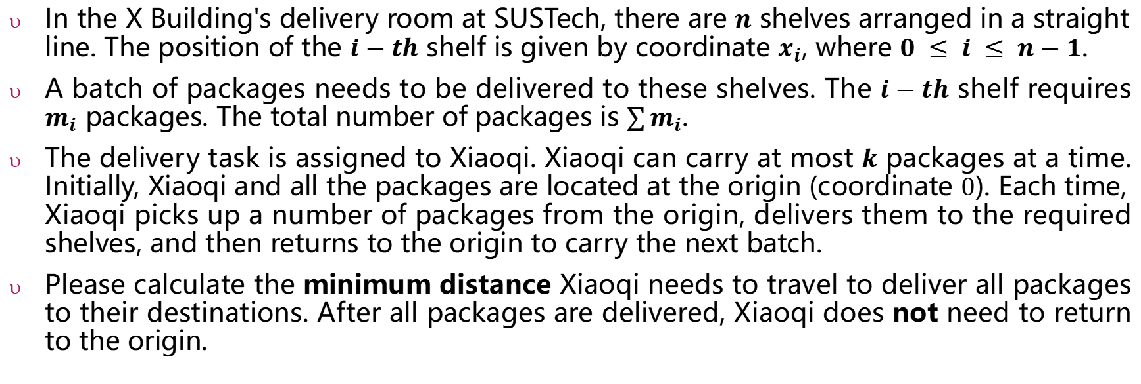
Lab5.B: Package Delivery Optimization
In the X Building's delivery room at SUSTech, there are $n$ shelves arranged in a straight line. The position of the $i−th$ shelf is given by coordinate $x_{i}$, where $0 ≤ i ≤ n−1$.
A batch of packages needs to be delivered to these shelves. The $i−th$ shelf requires $m_{i}$ packages. The total number of packages is $\sum{m_{i}}$.
The delivery task is assigned to Xiaoqi. Xiaoqi can carry at most $k$ packages at a time. Initially, Xiaoqi and all the packages are located at the origin (coordinate $0$). Each time, Xiaoqi picks up a number of packages from the origin, delivers them to the required shelves, and then returns to the origin to carry the next batch.
Please calculate the minimum distance Xiaoqi needs to travel to deliver all packages to their destinations. After all packages are delivered, Xiaoqi does not need to return to the origin.

Slide 7


Example 1
Input:
5 1
1 3 2 4 5
1 1 1 1 1
-1
0
1
2
3
4
5
0 → 1 → 0 → 2 → 0 → 3 → 0 → 4 → 5
Output
25
1 + 1 + 2 + 2 + 3 + 3 + 4 + 4 + 5 = 25

Slide 8
Example 2
Input:
5 3
-7 -9 -8 7 8
1 1 1 1 2
-9
-8
-7
0
7
8
0 → 7 → 8 → 0 → -7 → -8 → -9
Output
25
7 + 1 + 8 + 7 + 1 + 1 = 25

